Slide 1
IBM University Engagement Project Submission
“Exploring the Power of Agentic AI with IBM Granite and LangFlow”

Slide 2

Project Tile – AI-Powered Interview Preparation Coach
Domain of Project – Education / Career Development (Interview Preparation)
Student Name | Recent Passport Photo | Email ID | Mobile number [WhatsApp]
M S AKSHAYA |  | msaiakshaya09@gmail.com | 9182882736

Slide 3
Problem Statement -
Problem Statement : AI-Powered Interview Preparation Coach
The Challenge
Candidates preparing for interviews often struggle to get realistic, tailored practice and honest feedback. Generic question banks ignore their actual resume and the specific job they are applying for, and there is rarely anyone available on demand to critique the structure, relevance, and pacing of a practice answer.
The Objective
Build an AI-powered Interview Preparation Coach that gives candidates realistic, tailored mock interviews and instant feedback so they can practice and improve before the real thing. The solution should:
Tailored Question Generation – Generate interview questions from the candidate's resume, the job description, and (optionally) the target company.
Adjustable Type & Difficulty – Support Behavioral, Technical, and HR interview styles across Beginner, Intermediate, and Advanced difficulty.
Typed Answer Practice – Let candidates type their answers directly, keeping the experience fast and accessible anywhere.
Instant, Structured Feedback – Score relevance, check STAR structure, flag filler words/hesitation, and comment on pacing for every answer.
Core AI Modules –
Question Generator (builds tailored questions from resume + job description)
Answer Analyzer (scores and critiques each typed answer)
Resume Parser (extracts resume text from the uploaded PDF)
Skill-Gap Roadmap Builder (compares resume vs. JD, plans what to study)
Skill Roadmap Dashboard – Show matched skills vs. gap skills, with topics to study and an estimated time to interview-ready for each gap.

Slide 4
Proposed Solution -
Proposed Solution: AI-Powered Interview Preparation Coach
The proposed solution is a resume- and job-description-aware mock interview coach built using IBM watsonx.ai and the IBM Granite Foundation Model to generate tailored interview questions and give instant, structured feedback on typed answers. The system addresses gaps in interview preparation through a lightweight, modular Streamlit application.
At its core, the solution extracts the candidate's resume text via pdfplumber and combines it with the job description and target company as context for every model call, so every question and every piece of feedback is grounded in the candidate's actual background and the job's actual requirements — no static question bank required.
The system consists of four core modules:
Resume Parser extracts plain text from the candidate's uploaded PDF resume.
Question Generator crafts interview questions tailored to interview type (Behavioral/Technical/HR), difficulty, resume, job description, and target company.
Answer Analyzer scores each typed answer for relevance, STAR structure, filler words, and pacing, and gives a concrete improvement suggestion.
Skill-Gap Roadmap Builder compares resume skills against the job description and produces a prioritized study plan with topics and an estimated time per gap.
The solution includes a Streamlit dashboard that walks the candidate through mock interview questions one at a time and shows the skill-gap roadmap in an easy-to-scan layout.
All AI calls run directly against the IBM Granite Foundation Model hosted on IBM watsonx.ai — question generation, answer feedback, and skill-gap analysis all share one model client, keeping the architecture simple to run, explain, and extend.
Overall, this solution delivers an end-to-end mock interview coach that promotes interview readiness through personalized questions, real-time feedback, and a clear roadmap for closing skill gaps.

Slide 5
Technology Used
Streamlit – For building the interactive web app (resume upload, mock interview flow, feedback display, roadmap tab)
IBM Granite / watsonx.ai Foundation Model – configurable via the MODEL_ID setting – For natural language understanding, question generation, and feedback reasoning
IBM Cloud – It provides the infrastructure to build, deploy, and scale the Interview Prep Coach efficiently. IBM Cloud enables a reliable, secure, and scalable environment for hosting the app.
pdfplumber – For extracting plain text from the candidate's uploaded PDF resume, used as context for every AI call.
IBM Watsonx.ai - For hosted foundation-model inference, deployment, and AI governance
python-dotenv – For managing IBM Cloud credentials and configuration via a local .env file

Slide 6
Core Application Components Used -
1) Sidebar Inputs – Where candidates upload their resume PDF, paste the job description, and optionally enter a target company.
2) ai_engine.py (watsonx.ai client) - Sends prompts to the IBM Granite/watsonx.ai foundation model to generate questions, analyze answers, and build the skill-gap roadmap.
3) Model used - Configurable via MODEL_ID (a watsonx.ai-hosted Granite/Llama instruct model) → balances quality and response speed for real-time feedback
4) Feedback Panel -Displays the AI-generated relevance score, STAR structure feedback, filler-word flag, pacing note, strengths, and improvement suggestion.
5) resume_parser.py - Extracts and cleans plain text from the uploaded PDF resume using pdfplumber.
6) setup_check.py - verifies Python version, package installs, and .env credentials before the app runs.

Slide 7
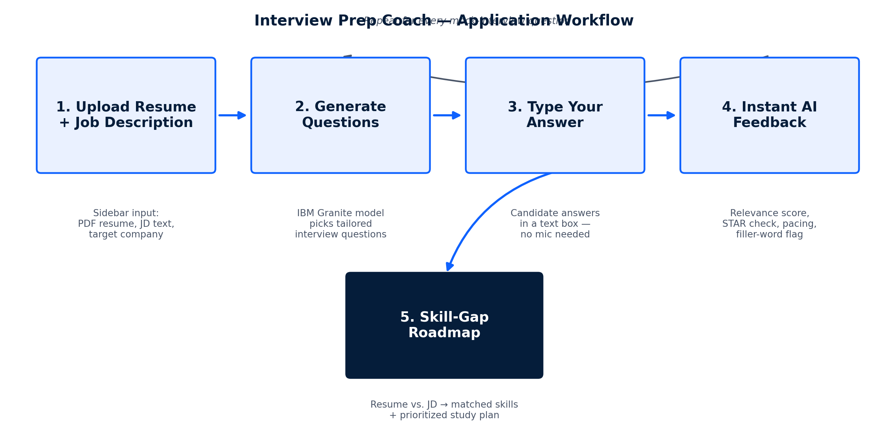
Application workflow -

Slide 8
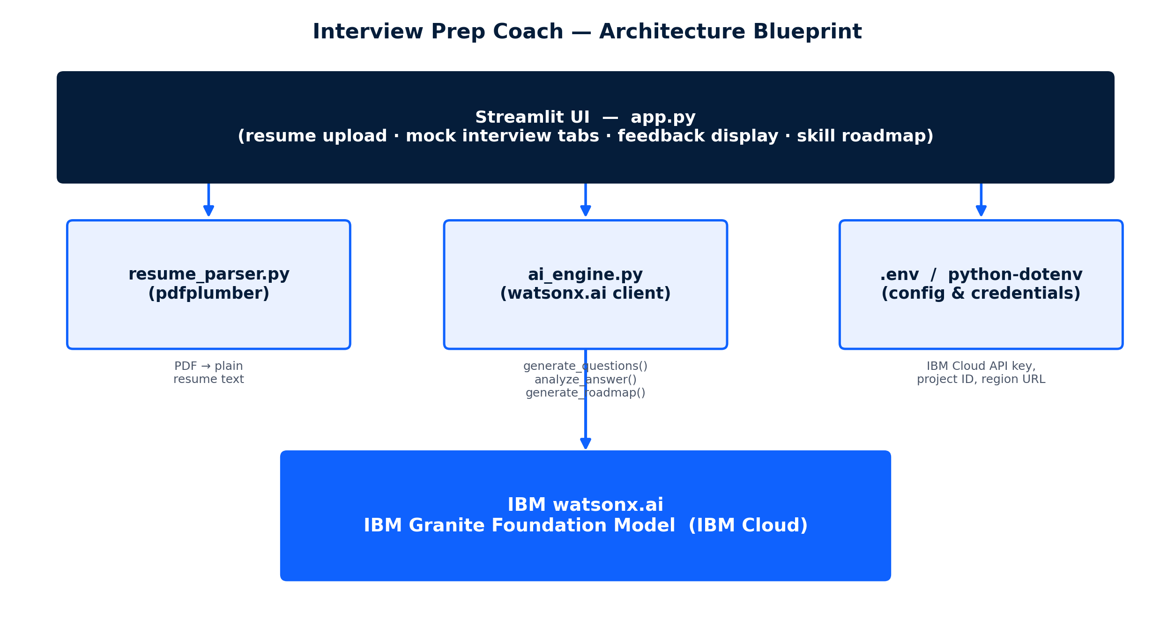
Architecture blueprint

Slide 9

Role of Generative AI in the solution
Role of Generative AI in the Interview Prep Coach
Generative AI lets the Interview Prep Coach go beyond a static question bank. Using IBM watsonx.ai and the IBM Granite Foundation Model, it performs three distinct jobs through one shared model client.
It plays the role of the interviewer (crafting tailored questions), the coach (scoring and critiquing each answer), and the career advisor (mapping skill gaps against the job description) — all grounded in the candidate's own resume and target role.
The model brings context awareness, using resume, job description, interview type, and difficulty to tailor every question and every piece of feedback. Answers are analyzed as soon as they're submitted, so feedback is available in real time.
Because question generation, answer analysis, and roadmap building all call the same Granite model, the system stays simple to reason about and easy to extend with new coaching modules.
Overall, Generative AI makes the system personalized and goal-driven, acting like a patient, always-available interview coach that helps candidates walk into the real interview prepared.

Slide 10
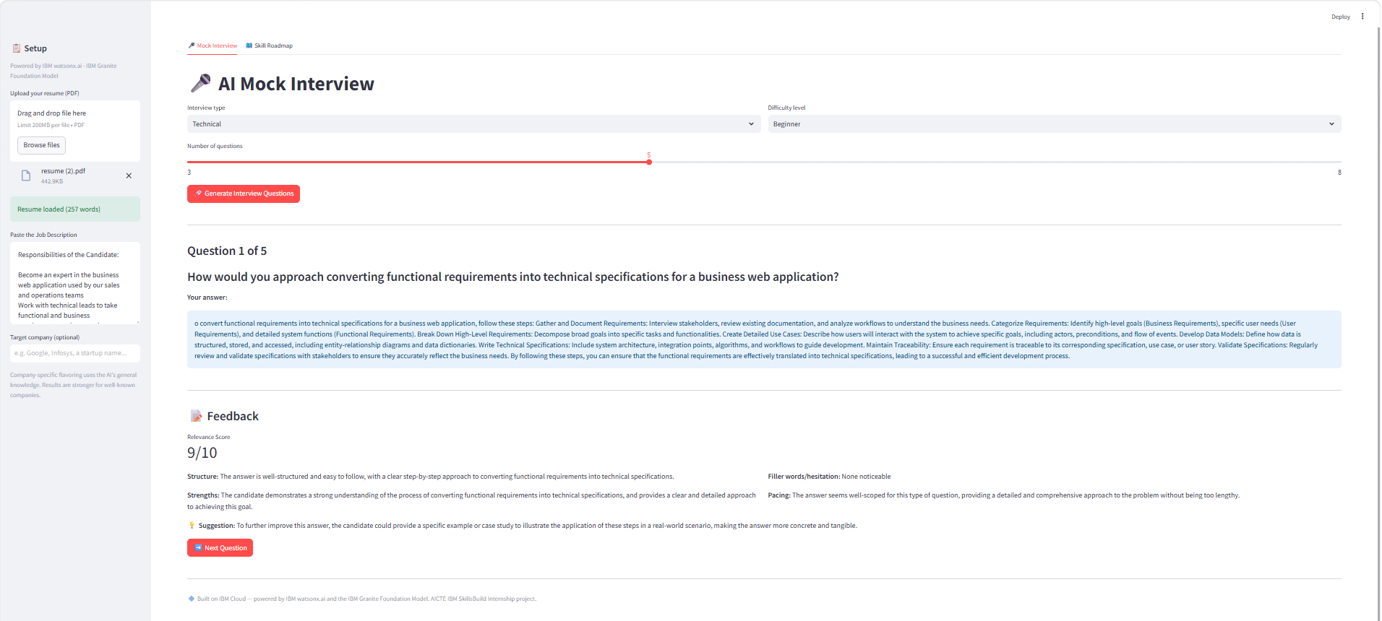
Visualizing Output

Slide 11
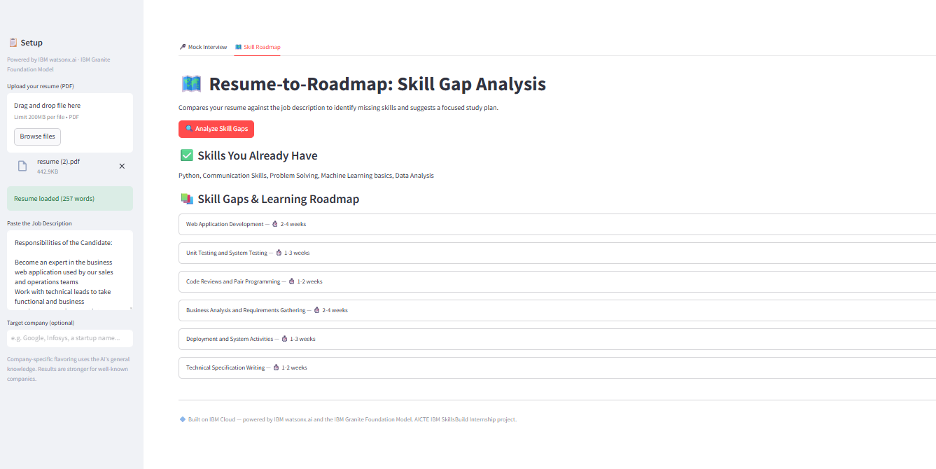

Slide 12
Novelty and Uniqueness
The proposed Interview Prep Coach stands out by combining resume-aware personalization, structured feedback, and a text-first workflow into a single lightweight system.
Resume + JD-Aware Questions – Every question is generated from the candidate's actual resume and the target job description, not a static bank.
Structured, Actionable Feedback – Each answer gets a relevance score, STAR-structure check, filler-word flag, and pacing note in one pass.
Company-Flavored Interviews – Optionally tailors question style to a named target company using the model's general knowledge.
Text-First, Accessible UX – Typed answers keep the experience fast and usable anywhere, with no microphone required.
Built-In Skill-Gap Roadmap – Goes beyond mock interviews to map missing skills against the JD, with topics to study and a realistic timeline.
Single, Lightweight Model Client – Question generation, feedback, and roadmap building all share one IBM watsonx.ai Granite client, keeping the architecture simple.
Scalable & Enterprise-Ready – Built on IBM watsonx.ai with the IBM Granite Foundation Model, ensuring reliability and governance.
This makes the solution a practical, end-to-end interview-readiness coach, not just a static list of practice questions.

Slide 13
Git Hub Link
https://github.com/MSaiAkshaya/AI-Powered-Interview-Preparation-coach-1
·
·
·

Slide 14
Future Scope
1. Voice-Answer Practice Mode –
Add an optional speech-to-text layer so candidates can practice answering out loud, while keeping typed answers as the default fast, accessible path. This would let users choose the practice style that fits their situation.
2. Adaptive Follow-Ups & Progress Tracking –
Generate adaptive follow-up questions based on answer quality, build a final aggregate “report card” per session, and track improvement across multiple mock-interview sessions over time.
·
·
·

Slide 15
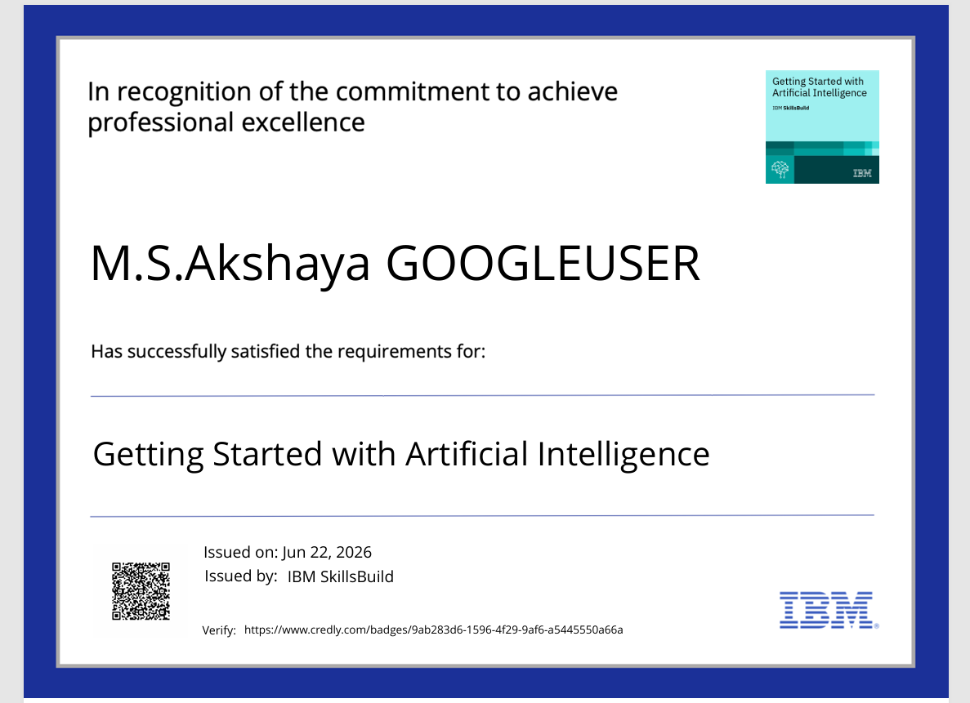
Certificates Earned:

Slide 16
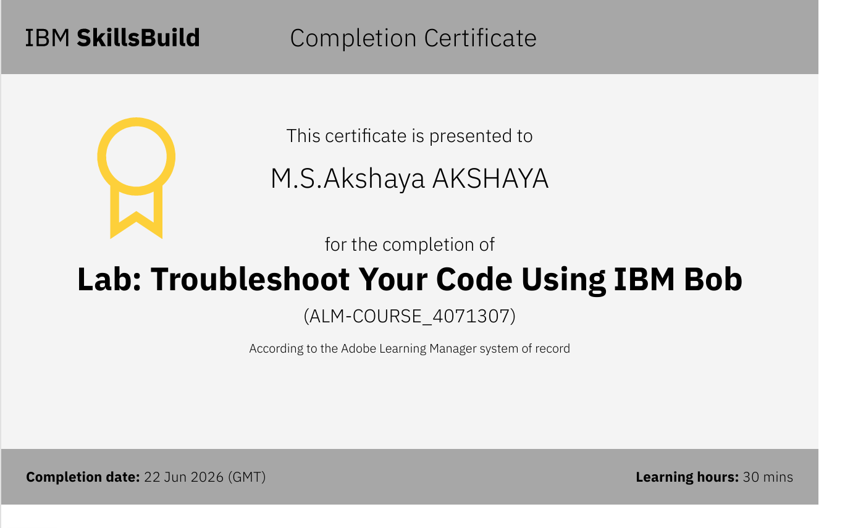
Certificates Earned:​

Slide 17


